Slide 1

Implementation of Man in the Middle Attack(Ettercap Tool)

Slide 2
TEAM MEMBERS:
K.DIMPLE(2010030436)
K.SIRISHA(2010030438)

Slide 4
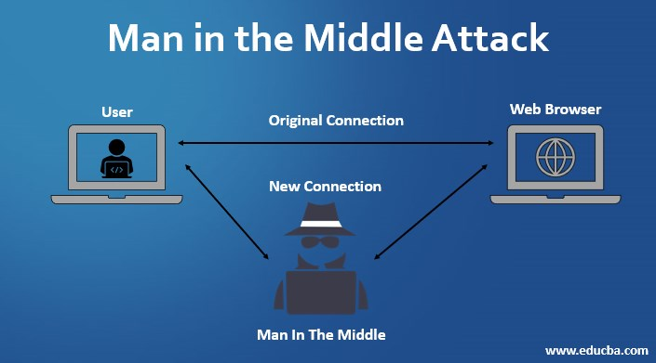

Slide 5
Prerequisites of MITM attack:
The attacker must obtain the following things in order to launch a successful MITM attack:
- Software to perform the attack
- Hardware to perform the attack
- Access to a computer on the targeted computers’ LAN OR
- Access to the targeted computers’ LAN
- Time
- Knowledge of the protocol he wished to manipulate

Slide 6
ARP:
Address Resolution Protocol:
ARP is used to find out the MAC Address of a particular device whose IP address is known.
ARP spoofing is a Man In The Middle (MITM) attack in which the attacker (hacker) sends forged ARP Messages. This allows the attacker to pretend as a legitimate user as it links the attacker machine’s MAC Address to the legitimate IP Address.

Slide 7
TOOLS:
Ettercap:
By using tools like ettercap you can easily detected manipulation of ARP entries. Ettercap has a built in detection mechanism which allows you to easily spot ARP changes and react accordingly.

